Slide 1
Secure Data Hiding In Images Using Steganography
CAPSTONE PROJECT
Presented By: Aryan Namdev
Student Name: Aryan Namdev
College Name: School of Information Technology, RGPV
Department: University Teaching Department
University: Rajiv Gandhi Proudyogiki Vishwavidyalaya

Slide 2
OUTLINE
Problem Statement
Technology used
Wow factor
End users
Result
Conclusion
Git-hub Link
Future scope

Slide 3
Problem Statement
Standard encryption techniques are often noticeable, which can attract unwanted attention.
A method is needed to securely embed private messages within picture files securely without changing picture.
Maintaining the confidentiality of the data while preserving the original appearance of the image is crucial.
The encryption and decryption process should be user-friendly, even for those without technical expertise.

Slide 4
Technology used
Programming Language: Python 3.12.6
Image Processing Library: OpenCV 4.11.0.86 (for image processing)
Security & File Handling: Password protection with basic encryption logic
Hardware Specifications:
RAM: 8 GB DDR3 DIMM SDRAM
Processor: Intel(R) Core(TM) i5-8350U CPU @ 1.70GHz 1.90 GHz
System Type: 64-bit operating system, x64-based processor
Operating System: Windows 10 Pro 22H2

Slide 5
Wow factors
Password Authentication: Requires a password to encrypt/decrypt,adding a security.
Pixel-Level Encryption:Embeds data directly into RGB channels without altering visual quality.
Lightweight & Simple:Minimal dependencies (only OpenCV) for easy setup and execution.
Error Handling: Checks message length against image capacity to avoid data loss.
Cross-Compatibility:Encrypted output is a standard PNG file,ensuring portability.

Slide 6
End users
Computer Science Students – Learning steganography concepts and their applications.
Cybersecurity Enthusiasts – Exploring secure communication techniques.
Government & Defense – Secure message transmission without raising suspicion.
Enterprise Applicsation – Concealing sensitive information in images to avoid surveillance.

Slide 7
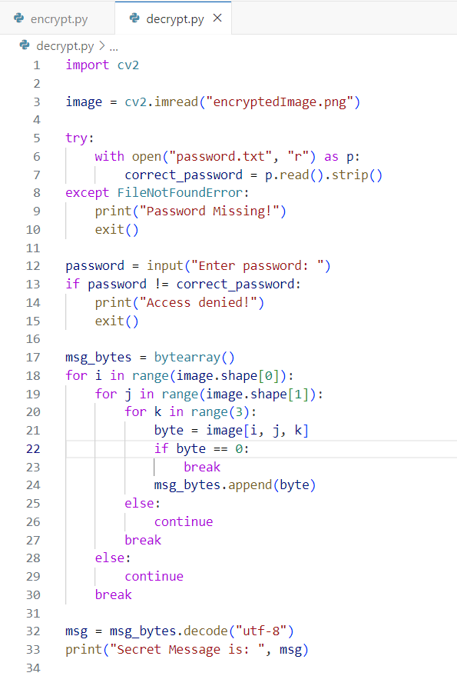
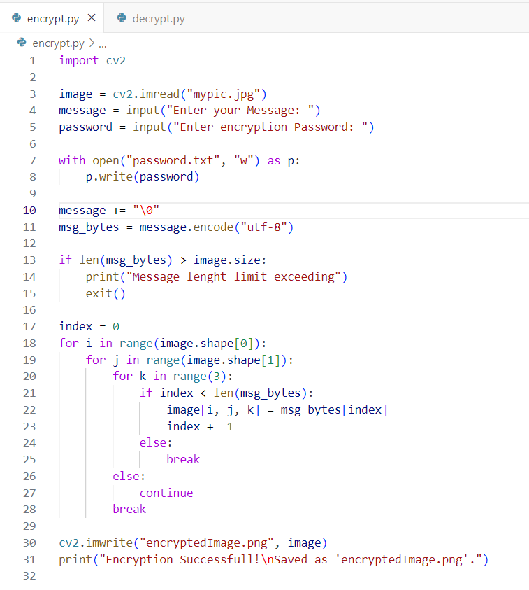
Results
Encryption code file
Decryption code file

Slide 8
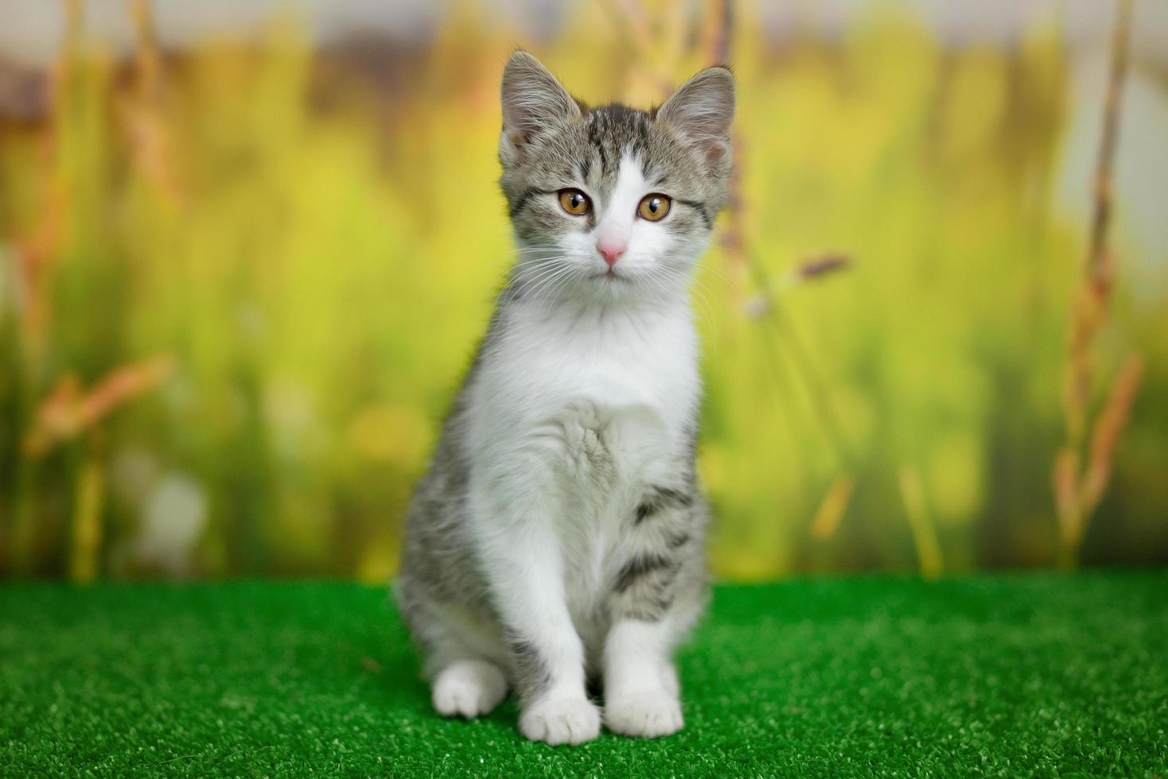

Results
Input (mypic.jpg)
Output (encryptedImage.png)

Slide 9
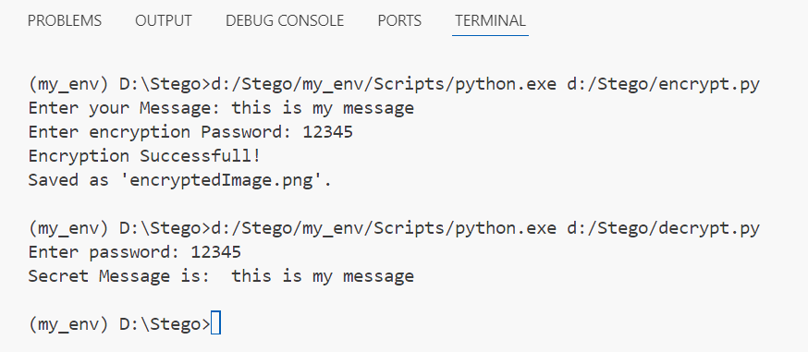
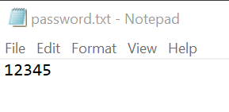
Results
Decryption password (password.txt)
Program execution (terminal)

Slide 10
Conclusion
Sensitive information can be secretly transmitted using steganography. (Combines and simplifies the first two points)
Messages are hidden within images by subtly altering pixel colors, making the changes undetectable to the eye. (Combines and simplifies the fourth point)
This implementation is designed for ease of use, relying on a single library (OpenCV) for broad compatibility. (Combines and simplifies the fifth point)
The output is a standard PNG image, facilitating easy sharing across different platforms. (Simplifies the sixth point)
This method merges steganography with basic encryption to provide a practical and secure way to hide data. (Simplifies the seventh point)

Slide 11
GitHub Link
https://github.com/Aryan0044/Stegonography.git

Slide 12
Future scope(optional)
Strengthen security by using AES encryption prior to hiding text within images. (Focuses on the benefit and simplifies the language.)
Extend the functionality to hide data in audio and video files, not just images. (More concise and emphasizes the expansion.)
Implement AI to prevent detection by current forensic methods, ensuring the hidden messages remain unseen. (Highlights the purpose of the AI integration.)
Make the technology available on mobile devices and the web, broadening its reach. (Emphasizes accessibility and reach.)
Achieve extremely high security by layering steganography with blockchain technology for communication. (Focuses on the level of security and the combination of technologies.

Slide 13
THANK YOU

